Slide 1
The Scrum-Agile Approach
Created By: Peter Truscinski

Slide 2

The Roles of Scrum
Product Owner
Scrum Master
Development Team
Tester
https://www.itjobs.ca/content/uploads/2018/09/Do-You-Have-What-It-Takes-to-Be-a-Scrum-Master.jpg

Slide 3
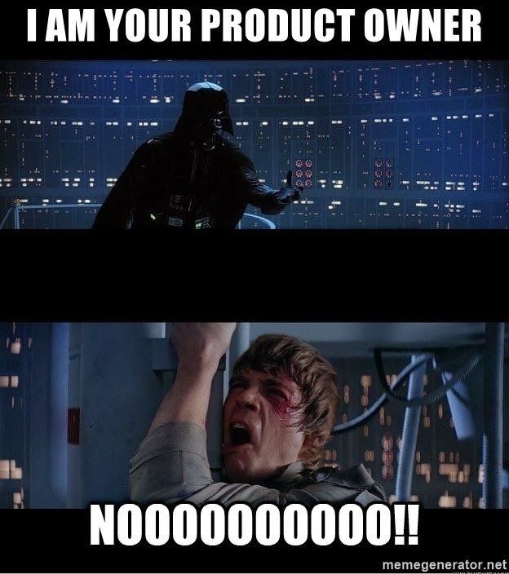
Product Owner
Holds the vision of the project
Responsible for maximizing the return on investment (ROI) of the project to the business
Owns and controls the order and priority of items on the product backlog
Acts as the liaison between the client and the Scrum team
Creates acceptance criterion for log items
https://memegenerator.net/img/instances/80676354/i-am-your-product-owner.jpg

Slide 4
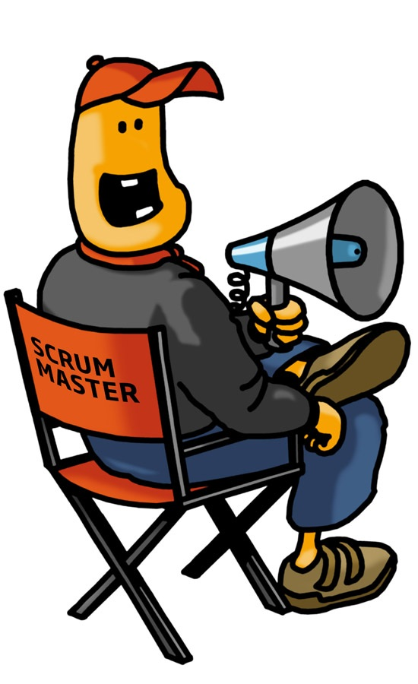
Scrum Master
Is a peer not a boss of Scrum team
Facilitates Scrum Events such as the Daily Scrum, Sprint Review and Retrospective
Facilitates and implements Scrum adoption
Removes any impediments and roadblocks to the success of the Scrum team
Coaches the team towards improvement and greater quality of the product
https://www.agileguru.xyz/wp-content/uploads/2017/05/Scrum-Master-Chair.jpg

Slide 5
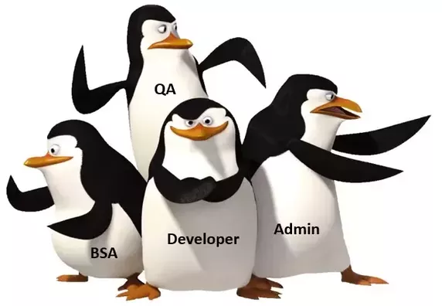
Development Team
Responsible for creating high-value user story iterations that aim to continuously improve on and progress towards the Sprint Goal
Self-organizing and cross-functional
Creates estimations of each user story
No titles or sub-groups
https://qph.fs.quoracdn.net/main-qimg-7f8acd0afbe265d3d559cead9d8068e2

Slide 6

Tester
Writes and executes automated tests and reports findings to Scrum team
Work with Product Owner to define acceptance criteria for the definition of done
Reports defects and bugs within user story to development team
Active with clients, Product Owner, and development team to update/clarify any requirements
https://screenskills-umb-media-cache.azureedge.net/7/5/b/2/6/b/75b26b9ef155316991c008f0a1d030adeb4c7f58.png

Slide 7
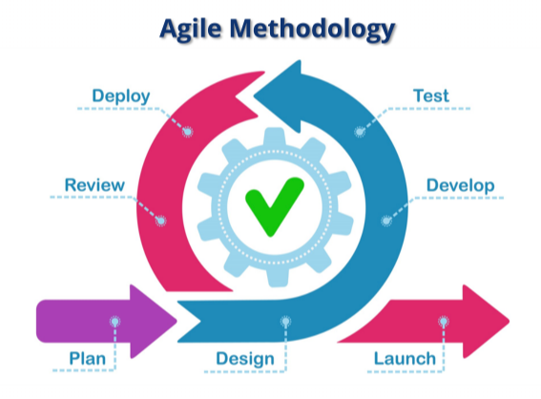
SDLC Phases under an Agile Environment
Iterative, team-based approach to development
Tasks are itemized into Sprints that have a specified duration
If work is not completed, it is reprioritized and facilitated into future Spring Planning
High level of client feedback and interaction
http://snhu-media.snhu.edu/files/course_repository/undergraduate/cs/cs250/storyline/mod1/story_html5.html

Slide 8
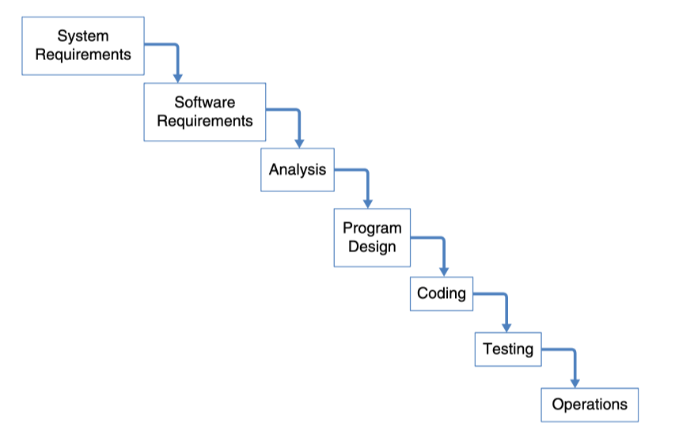
How is the Waterfall Model SDLC different?
Waterfall is a linear and sequential approach where each stage must be finished before the next
Heavy emphasis on planning and staging phase of development
Progress is inherently more easily measured
Each step in the the development process must be approved by the project stakeholders

Slide 9

When to use the Waterfall Model Over Agile?
Have a fixed, inflexible budget
Working on and enhancing an already existing product
Have a firm and fixed timeline
If the requirements of the project are well-known and you need to operate within a fixed budget and timeline then you may find that the Waterfall Model is the right choice for your particular project
https://img.pngio.com/waterfall-illustration-waterfall-clipart-waterfall-cartoon-png-waterfall-illustration-png-650_650.png

Slide 10
References
Ghahrai, A. (2017, January 06). Agile Testing Mindset and the Role of the Agile Tester. Retrieved from https://devqa.io/agile-testing-mindset-tester-role-agile-team/
Charles G. Cobb. (2015). The Project Manager's Guide to Mastering Agile: Principles and Practices for an Adaptive Approach. Wiley.
Sims, C., & Johnson, H. L. (n.d.). Scrum: A Breathtakingly Brief And Agile Introduction. Retrieved February 20, 2021, from https://agilelearninglabs.com/resources/scrum-introduction/
Lotz, M., & About the Author Mary Lotz is Segue's Director of Engineering. She is a certified project manager (PMP) and scrum master (CSM). (2018, November 20). Waterfall vs. Agile: Which Methodology is Right for Your Project? Retrieved February 20, 2021, from https://www.seguetech.com/waterfall-vs-agile-methodology/
Parsons, T. (2019, May 17). When to Use Waterfall vs. Agile. Retrieved February 20, 2021, from https://www.macadamian.com/learn/when-to-use-waterfall-vs-agile/

